Slide 1

Health workforce performance and the use of bundles of human resources/health systems strategies

Slide 2
Overview
Links between human resources for health and health outcomes
Interventions to improve staffing levels
Understanding individual staff performance
Areas for consideration for managing workforce performance
The concept of ‘bundles’ of strategies
Examples of bundles of human resources/health systems strategies
Notes:
The session does NOT aim to develop competencies for putting the bundles together.

Slide 3
Logical links between HRH and health outcomes
HR strategies
Improved
Health
workforce
Other health system components
Health
services
Better
Health
outcomes
Adapted from www.capacityproject.org/framework
Notes:
This is part of a more complex framework for looking at the links between human resources strategies and outcomes. This is as relevant to the district level as national or global level. (The full diagram is available at: www.capacityproject.org/framework). The diagram is useful for discussions checking the links to human resources e.g. Do we need more plastic surgeons? And for understanding causal relationships e.g. Why is Maternal Mortality Rate so high? It also shows that other health systems components (e.g. finance, information systems, supplies) are also essential for effective health services. We will shortly see how closely these other health systems components link to HR strategies.
But first, let’s discuss what the we mean by the term ‘workforce performance’

Slide 4
PERFORM’s definition of health workforce performance
Both collective and individual performance
Clinical, managerial and support staff
Availability of staff
  Right number, competencies, in right place
  Levels of absence
Quality and quantity of work output
Notes:
1. In PERFORM we are looking at the performance of the workforce as a whole within the district. This means that we are concerned with the overall staffing to carry out the tasks to deliver planned services. So well look at the workforce in a collective way (Are there enough? Are the right types of staff (cadres) in the right place?) We are also concerned about managing individuals who are in post (Do they need more skills? Should they be promoted? Are they frequently absent from work?) The performance of the collective workforce is largely a result of management decisions. The performance of individual is a result of interactions between managers and/or supervisors and the individual health worker (other factors are involved, but don’t go into too much depth when making this point). (Note: this seems to be a difficult concept to get across, but don’t spend too much time on it. It will come up again in later and may make more sense by then).
2. The services delivered within the district are the result of actions carried out by clinical staff, managers (including supervisors) and support staff (drivers, security guards, administrative clerks etc.) It is therefore necessary to manage the performance of all three groups, not just clinical staff. Ask what the impact of the poor performance of a group of support staff, for example administrative clerks, on service delivery might be to confirm the importance of including all groups of staff in performance management.
3. There is no performance without staff! Managers need to do their best to ensure posts are filled – including in remoter facilities – with staff who have the right competencies, so their effort can be transformed into performance (this is an example of managing the collective workforce). Even if the right staff are posted, some may often be absent (this may be for other tasks, training, annual leave – or the absence may not have been sanctioned) and there is no possibility of effort being transformed into performance. Managers may need to take actions to reduce staff absence (this is an example of managing the individual). Use any relevant examples of the problems of availability of staff from the presentations on Day 1.
4. Assuming staff are in post and are available for work, it is possible to address performance in terms of the quality and quantity (this relates to efficiency of the way staff work or are used) of work output. Use examples from the presentations on Day 1 of problems of both quality and quantity of work output.
There are a range of human resources interventions that can be used to address workforce performance problems. It is sometimes useful to divide these into those that address the collective workforce (e.g. availability of staff in terms of right number, skills, in the right place) and those that address the performance of individuals. We start with addressing the collective workforce.

Slide 5
Interventions to improve staffing levels
HR strategies
HS strategies
Develop partnerships (MoH, other sectors, NGOs, FBOs
non-formal providers)
Change skills mix
(inc. volunteers)
Increase entrants
Reduce losses
Improve distribution
Improve productivity
Notes:
This diagram shows the organisation in the blue disc. Think of this as the district as a whole. There are six broad ways in which the number of staff can be increased (or decreased, in some cases). This provides ideas of the sort of strategies that could be selected, though some may not be appropriate to the district level. We will go into more detail later in the process, at the second stakeholder workshop.
Increase entrants: possible strategies include training more staff, recruiting more staff (if finances allow), getting staff transferred from other districts/institutions, contracting retired staff.
Improve distribution: this does not increase the overall number of staff, but gets them “in the right place” to allow more equitable service delivery. Sometimes there is a surplus in urban areas and staff are underemployed. Better distribution therefore may result in more efficient use of the collective workforce. Possible strategies include: use of incentives to attract to and/or retain in rural areas; staff rotation or temporary placements; improving living and/or working conditions in rural areas to attract and retain staff; and including rural placement as part of a contract for attending training.
Improve productivity: again, this does not increase the overall number of staff, but there will be increased output (number of tasks carried out) from the existing staff, reducing the need for more staff. Productivity will be discussed in the next section.
Reduce losses: There is no point in increasing the number of entrants, if lots of staff are leaving. Retention strategies include developing career opportunities within the district; sponsoring further training with bonding; job redesign to improve job satisfaction.
Changing skills mix (including the use of volunteers). This relates to the distribution of tasks (currently referred to as “task shifting”) to make better use of the existing workforce. For example, non-clinical staff could take on counselling tasks in a Voluntary Counselling and Testing service, to allow clinical staff to concentrate on tasks requiring their often scarce sets of skills. This means that it might be possible to improve the productivity of the existing workforce. Volunteers may also be used to carry out certain tasks.
Developing partnerships with other providers: this may involve sharing work by mutual agreement or contracting out services. This will not increase the number of staff managed by the District Health Management Team, but it may be making better use of the overall health workforce (government, faith-based organisations, NGOs)
Most of the six areas discussed could be called human resources strategies (show red oval). Improving productivity may involve increasing availability of supplies or equipment. These are wider health systems areas. Partnership and contracting are also wider health systems strategies (show green oval).
As we have said before, we are trying to use a mixture of both human resources and health systems strategies to improve workforce performance. We have just discussed strategies for getting enough staff with the right competencies in the right place. Next we will discuss the performance in the job.

Slide 6
Understanding individual staff performance
HR strategies
Job
satisfaction
Direction
Competencies
Intrinsic
Reward/
Sanction
Extrinsic
Effort
Performance
Resources
Fairness
Praise, incentives, etc
HS strategies
Notes:
Unlike other resources in the health system, people make choices about what they do and how they do it. It sometimes difficult to understand how these choices are made. But they are usually quite rational. The simple model we are about to discuss helps us to understand how the choices might be made – and therefore what strategies might be useful for influencing these choices.
We start with the person putting in effort (of course this is not possible, if they are absent!). The effort will be translated into desired performance (i.e. to deliver planned services), if the following three conditions are met. 1. Direction: knowing what they should do through clear job descriptions, workplans, planning meetings, targets etc.) 2. competencies (including knowledge, skills and attitude) to enable them to carry out the task with confidence; 3. Resources: the equipment and supplies to do the job.
The level of performance achieved will result in some kind of ‘reward’ – or sometimes sanction or punishment. Some rewards come the job itself (which is why it is called intrinsic) – the feeling of having done a job well, of helping other people – sometimes referred to as job satisfaction. Some reward comes from outside the job (extrinsic) and may include praise from the supervisor, financial incentives, increased chance of promotion; this may also include ‘sanctions’ such as criticism by the manager, reduced chance of promotions and withholding of financial incentives. Different people look for different mixes of intrinsic and extrinsic reward – and this may change over their working life-time.
If people get the rewards (intrinsic and/or extrinsic) they think they deserve as a result of their performance, they will continue to maintain their level of effort – or may wish to increase it. If staff cannot see any connection between their performance and the rewards they get (unless intrinsic rewards are the most important) they tend to reduce their effort as the system is not seen as fair.
Most of the areas in this diagram that indicate where improvements to the system could be made relate to human resources strategies e.g. providing job descriptions, improving competences, providing rewards. Health systems strategies – such as effective work planning, ensuring necessary resources are available – are also needed.

Slide 7
Areas for consideration for managing workforce performance
Availability
Direction
Competencies
Resources
Fair rewards and sanctions
Other supporting health systems components
Notes:
So the areas we need to concentrate on when managing workforce performance are:
Staff availability (both ensuring sufficient staff are posted and at post)
Staff are clear what needs to be done (direction)
They have the skills, knowledge and attitudes appropriate for carrying out the tasks
And the resources
Rewards and sanctions need to appropriate to the staff
And need to be perceived by them as being fair – so systems need to be transparent.
Other health systems components (e.g. resources) are important for supporting workforce performance

Slide 8
The concept of ‘bundles’ of strategies
No single magic bullet for a sustainable solution
Coordinated ‘bundle’ of HR strategies have greater impact that individual strategies
Avoid ‘deadly combinations’ of HR practices
Add wider health systems strategies to the ‘bundles’
Effectiveness of the bundles depends on organisational context
Notes:
The concept of using several strategies together to achieve an objective in the area of human resources management is referred to as ‘bundling’. This comes from the view that no single strategy will solve a problem in the long term. This is partly because there may be several causes of the problem that all need to be addressed (so poor performance might be due to lack of certain skills but also because staff are unclear what tasks they should be performing). Or strategies may solve a problem in the short term (e.g. financial incentives), but other strategies are needed to solve the problem in the longer term (e.g. policy change). So,
There is no single magic bullet for a sustainable solution.
A coordinated set of strategies (strategies that support each other e.g. training used with follow-up supervision) will have greater impact than single strategies
It’s not just a matter of having more strategies – we need to avoid having contradictory strategies (the deadly combination) like trying to develop team work at the same time as introducing individual performance pay.
We have seen that strategies from wider health systems components may need to be included in the bundles. While the idea of bundles of human resources strategies has been around for quite a long time, the inclusion of health systems strategies is, as far as we know, new. So you will be pioneers!
We cannot prescribe a fixed bundle of strategies for every situation. It will depend on the particular problem and the context in which you are working. A bundle may work well in one of your districts, but not another because the context is different. So each bundle of strategies has to be tailor-made.

Slide 9
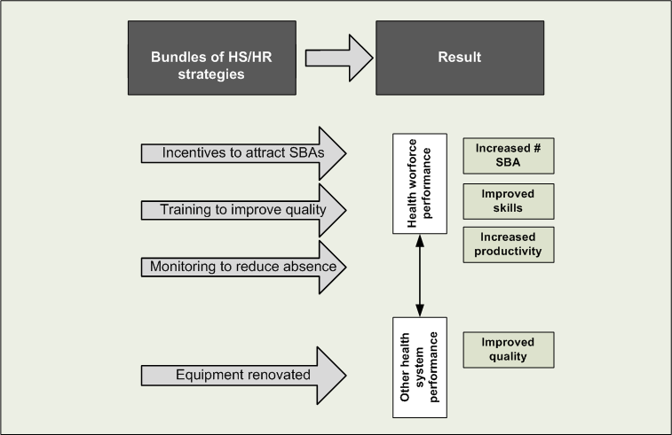
Example of a bundle of human resources/health systems strategies in DHMT guidelines
Notes:
The relevant health workforce problems identified in this example might include the shortage of skilled birth attendants (SBA), poor quality due to insufficient skills and amongst those staff actually in post, poor attendance at work leading to low productivity.
The human resources and health systems strategies are collectively designed to address these problems (refer to the arrows):
Incentives are offered to attract more SBAs to work in the district.
In-service training is provided to improve the quality of work.
Absence monitoring is introduced to improve staff attendance and thereby improve productivity of the existing staff.
Poor equipment (e.g. incomplete delivery sets, lack of vacuum extractor) is identified as contributing to low quality, so this is addressed by the renovation and maintenance of this equipment.
The expected change from this bundle of human resources/health systems strategies will be more, better skilled SBAs available for and turning up to work; and working with functional equipment to do the job.

Slide 10
What bundles of HR/HS strategies have you used?
Notes:
Ask for examples
Be sure to ask what the expected result was (as in the previous diagram) – and what the actual result was

Slide 11
Next steps
One worked example for developing a list of strategies for one problem
Development of preliminary list of strategies for the problems identified in your situation analysis
Notes:
These steps are explained in the Guideline for the workshop

