Slide 1
About PERFORM2Scale

Slide 2
Aim of PERFORM2Scale To develop and evaluate a sustainable approach to scaling-up a district level management strengthening intervention in different and changing contexts
PERFORM MSI
Scale-up mechanism
Process and outcome evaluation
Notes:
The aim was to learn about scale-up using a tested and wanted intervention which we referred to as the ‘management strengthening intervention’ – or MSI.
The MSI had previously been tested in the PERFORM programme (2011-15) during which management teams solved workforce performance problems, within existing resource constraints, that improved service delivery and helped them to become better managers. During the programme we conducted process and outcome evaluations.

Slide 3
Adaptation of ExpandNet/WHO framework for scaling-up
Process led by the Country Resource Team (CRT)
MSI
Context
National Scale-up Support Group (NSSG)
Resource Team (RT)
Vertical scale-up: institutionalization through policy, political, legal, budgetary or other health systems changes in particular to support the horizontal scale-up
Horizontal scale-up (during and beyond project): expansion and/or replication of the intervention across the country
Notes:
This is an adaptation of the ExpandNet framework which we used to guide the programme. The MSI is the intervention
The role of the National Scale-up Steering Group (NSSG) as 'user organisation’ is to manage the scale-up – taking key decisions on locations during the project period and developing the strategy for expansion – including securing resources – beyond the project. They were also to select and 'manage' the Resource Team (RT).
The role of the Resource Team was to gradually take over the running of the MSI in new districts
Context: decentralized – selected for greater decision space. Then came COVID-19
PERFORM2Scale’s focus was on building the infrastructure to carry on the scale-up, but also to carry this out during the project
There are two components of the scale up strategy. First, the expansion of the MSI across districts as per the horizontal plan developed at the start of the project with the NSSG and RT which is funded by the PERFORM2Scale project. Second, the scale-up strategy which includes what happens beyond the initial horizontal scale-up and after the end of the project. This incorporates the concepts of handover and the funded absorption of the MSI into structures and policies.

Slide 4
What is action research?
Definition: “an enquiry which is conducted by a group on a problem which is of interest to them”
Aims:
to improve practice
to generate knowledge about the processes and strategies that work best to create that improvement
Source: Reason and Bradbury, 2001

Slide 5
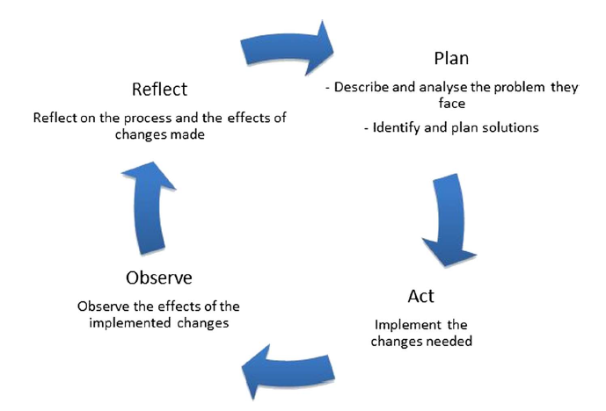
The elements of the action research cycle
Source: Mshelia et al 2013 p3
Notes:
Similar to Michael Kolb’s learning cycle – most people just carry out the plan and do/act steps and never learn
Implications for supporting DHMTs – next slide …

Slide 6
Implications for the action research cycle to be effective
Identify problems of real concern (ownership)
Put real plan into action
Observe/measure effects
Have the time and inclination to reflect on process and effects (generate knowledge)
Apply lessons to future plans/AR cycles (improve practice)
Notes:
Identify problems of real concern (as in Action Learning)
Put plan into action (unlike theoretical classroom learning - even with case studies/simulation)
Be able to observe/measure effects
Have the time and inclination to reflect on process and effects (this becomes the learning)
Apply lessons to future plan
Risks is that without observations and, in particular, reflection – just a crisis management process

Slide 7
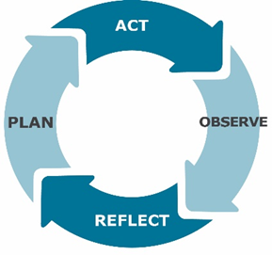
Management Strengthening Intervention (MSI)
Implement strategies
Total length of time for one MSI cycle: approximately 10 months
Initial engagement
Situation Analysis
MSI Workshop 1: problem analysis
MSI Cycle
Further problem analysis in district
Observe and reflect:
2 visits by CRT
2 inter-district meetings
MSI Workshop 2: develop strategies and workplan
Notes:
The MSI is based on the core principle of learning through action and reflection
Initial visits by the Country Research Team and short workshops (at the ‘plan’ stage) with further visits and inter-district meetings during the implementation period were designed to lead DHMTs through the MSI cycle;

Slide 8
Repeated cycles = embedded learning
Notes:
By running repeated MSI cycles the learning becomes embedded in both the DHMTs and the health system

Slide 9
Liverpool School of Tropical Medicine, UK
Participating countries
Royal Tropical Institute, Netherlands
Trinity College Dublin & Maynooth University, Ireland
Swiss Tropical and Public Health Institute
Linked three African partners with four European partners
Makerere School of Public Health, Uganda
University of Ghana
REACH Trust, Malawi
Notes:
PERFORM2Scale was run in three African countries – Ghana, Malawi and Uganda – selected because they were decentralised contexts where District Health Management Teams had a greater level of autonomy (decision space). Ghana and Uganda had previously been involved in PERFORM.
Country Research Teams from three institutions were supported in the delivery of the programme and its evaluation by four European partners.

Slide 10
Research questions | Methods
Initial context analysis
1. How could political and economic structures influence scale-up of the MSI? 2. How could stakeholders and relations between these stakeholders influence scale-up of the MSI? | Document review Reflection with Country Research Team Interviews with stakeholders, eg MoH, DHMTs, local government
Process evaluation
3. How is the MSI implemented? 4. How is the MSI scale-up strategy implemented? 5. How do factors, processes and initiatives facilitate or hinder implementation of the MSI? 6. How do factors, processes and initiatives facilitate or hinder implementation of the scale-up of the MSI? | Tracking MSI and scale-up implementation Scale-up assessment with Resource Team, National Scale-up Steering Group Interviews with DHMTs Reflection with Country Research Team
Outcome evaluation
7. What are the effects of MSI on management strengthening, workforce performance and service delivery? 8. What are the outcomes/effects of scaling-up the MSI? 9. What are the costs of the MSI? 10. What are the costs of scaling-up the MSI? | Tracking and costing of MSI and scale-up implementation District situation analysis and HMIS synthesis Management competency survey with DHMTs Decision space assessment with DHMTs HR strategies survey with health workers
Research questions
& methods
Notes:
The project planned both process and outcome evaluation activities to identify lessons about implementing and scaling-up the MSI in line with the Theory of Change and its underlying assumptions. We used a range of quantitative and qualitative methods to answer the research questions as outlined here.

Slide 11
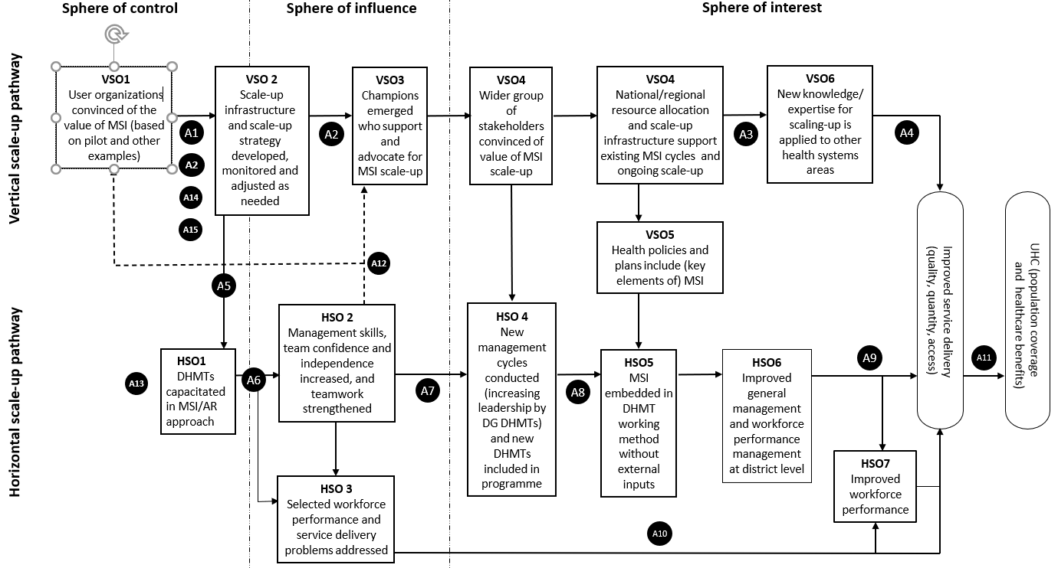
PERFORM2Scale Theory of Change
Notes:
The Theory of Change consists of two pathways: Pathway 1 on the scale-up process (vertical scale-up) and Pathway 2 on the management strengthening process (horizontal scale-up). The purpose of this Theory of Change is to clarify the main outcomes and the necessary processes and associated assumptions to achieve these outcomes over the whole project period. The assumptions which underpin the theory – can which changed slightly during the programme are shown below and are given in the full document available at: https://www.perform2scale.org/theory-of-change-for-scaling-up-management-strengthening-at-district-level-to-support-the
Key stakeholders are convinced by the available evidence about the MSI and are initially (assumption 1a) and remain (assumption 1b) willing to collaborate with the scale-up process
Attention of National Scale-up Steering Group members (assumption 2a) and Resource Team members (assumption 2b, added in 2018) not diverted by other priorities; low staff turnover of National Scale-up Steering Group members (assumption 2c, added in 2020)
New knowledge on scale-up lessons is sufficiently well documented (assumption 3a) and disseminated (assumption 3b)
Sufficient opportunities to apply scale-up knowledge available
DHMTs willing to participate in the intervention even though no implementation funds are provided
Effective facilitation skills of Country Research Team (assumption 6a) and Resource Team (assumption 6b) during action research cycles; work plan developed by DHMTs are feasible (time-frame, decision-authority, resources) (assumption 6c) and address real problems (assumption 6d)
DHMTs remain convinced of the value of the MSI (assumption 7a); and sufficient support available from Resource Team to support expansion of district groups (assumption 7b)
Resource Team members develop sufficient facilitation skills from working with new district groups (assumption 8a); low turnover of Resource Team members (assumption 8b)
DHMT remains key organisational structure at sub-national level (assumption 9a); DHMT works as a team (assumption 9b); low turnover of DHMT members (assumption 9c); decision-space does not decrease (assumption 9d)
DHMT’s involvement in this project, with the consequent opportunity costs, does not undermine (through possible diversion in project activities) health service delivery
Service delivery plans remain in line with health care needs
New knowledge on MSI lessons is sufficiently well documented (assumption 12a, added in 2019) and disseminated to relevant stakeholders (assumption 12b, added in 2019)
The MSI is a scalable intervention, and if needed further adapted to the context in which it is implemented (added in 2021)
There is an understanding of power relationships between key stakeholders, which could potentially hinder or facilitate scale-up
Windows of opportunity to integrate (parts of) the MSI in existing structures and strategies are identified and used (added in 2021)

Slide 12
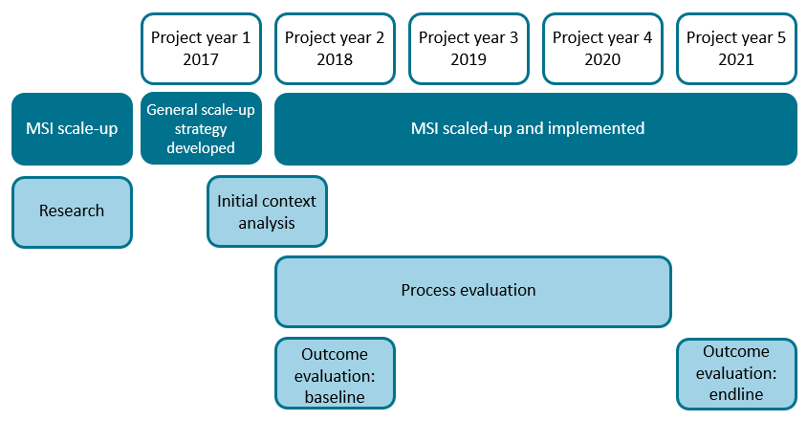
Timeline of activities
Notes:
We developed a general/non-country specific scale-up strategy and conducted the initial context analyses in each country in 2017. From 2018 to 2021 we implemented the MSI, expanding it across geographical areas in each country. At the same time, we worked to operationalise the scale-up framework in each country and, together with the user organisations, we developed country-specific scale-up strategies to institutionalise the MSI in national policy, plans, guidelines or curricula. Research activities, including process and outcome evaluation, ran throughout this period.

Slide 13
Initial scale-up plan for each country (within the project)
District group | Implementation stage |  |  | Planned but not supported by project | #Districts
Year | 2018 | 2019 | 2020 | 2021
DG1 | MSI 1 | MSI 2 | MSI 3 | MSI 4 | 3
DG2 |  | MSI 1 | MSI 2 | MIS 3 | 3
DG3 |  |  | MSI 1 | MSI 2 | 3
DG4 |  |  |  | MSI 1 | 3
Totals |  |  |  |  | 12
Notes:
Working with groups of three districts the plan was to take on one new group of districts each year while continuing support for existing district groups and for the project to be supported up to end of 2020 with the vertical scale-up process through the NSSG continuing the scale-up from 2021. Because of COVID-19, among other reasons, support was continued in 2021, covering 27 districts and carrying out up to 3 cycles in DG1.

Slide 14
Progress in scale-up of the MSI by country, district group and project year
District group/ county | Implementation stage |  |  |  | #Districts | #MSI cycles
Project Year | PY2 - 2018 | PY3 - 2019 | PY4 -2020 | PY5 - 2021
Ghana
DG1 | MSI1 | MSI2 | MSI 2 cont’d | MSI 2 cont’d | 3 | 2
DG2 |  | MSI1 | MIS1 cont’d | MSI2 | 3 | 2
DG3 |  |  |  | MSI1 | 3 | 1
Uganda
DG1 | MSI1 | MSI2 | MSI3 | MSI3 cont’d | 3 | 3
DG2 |  | MSI1 | MSI2 | MSI2 cont’d | 3 | 2
DG3 |  |  | MSI1 | MSI1 cont’d | 3 | 1
Malawi
DG1 | MSI1 | MSI2 | MSI2 cont’d | MSI2 cont’d | 3 | 2
DG2 |  | MSI1 | MSI 1 cont’d | MSI 1 cont’d | 3 | 1
DG3 |  |  |  | MSI1 | 3 | 1
Totals | 3 | 6 | 7 | 9 | 27 | 15
Notes:
The support from the Ministries of Health in Malawi and Uganda and the Eastern Regional Directorate of Health in Ghana continued during the project period. As a result, the MSI was introduced in two district groups (each comprising three DHMTs) in Ghana and Malawi. A third group in both countries was started. In Uganda, the MSI was conducted fully in three district groups.
As was confirmed by a number of the DHMT members, management strengthening deepened as a result of repeated MSI cycles. In Uganda, they completed three cycles in the first group of districts, whereas Ghana and Malawi completed two. Details and the timing of the MSI cycles are shown here

Slide 15
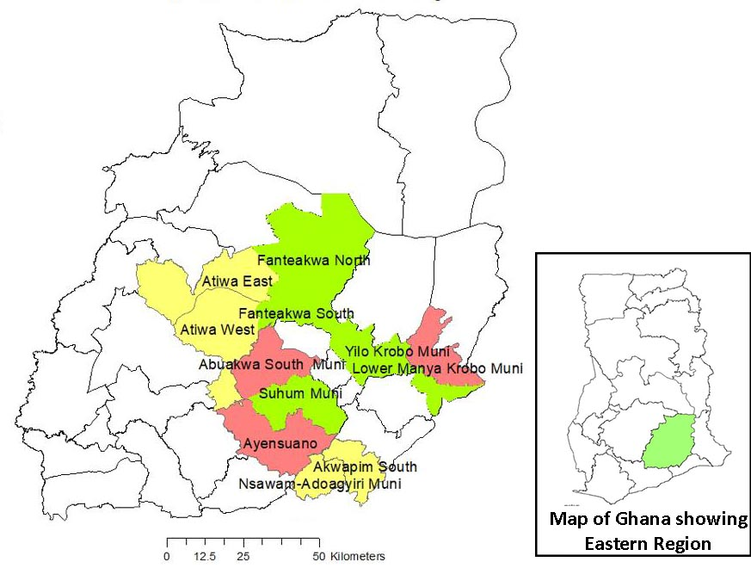
PERFORM2Scale in Ghana
District group | Implementation stage |  |  |  | #Districts | #MSI cycles
Project Year | PY2 - 2018 | PY3 - 2019 | PY4 -2020 | PY5 - 2021
DG1 | MSI1 | MSI2 | MSI 2 cont’d | MSI 2 cont’d | 3 | 2
DG2 |  | MSI1 | MIS1 cont’d | MSI2 | 3 | 2
DG3 |  |  |  | MSI1 | 3 | 1
DG1 - Fanteakwa, Yilo Krobo and Suhum
DG2 - Ayensuano, Lower Manya Krobo and East Akim
DG3 – Nsawam-Adoagyiri, Akuapim South and Atiwa

Slide 16
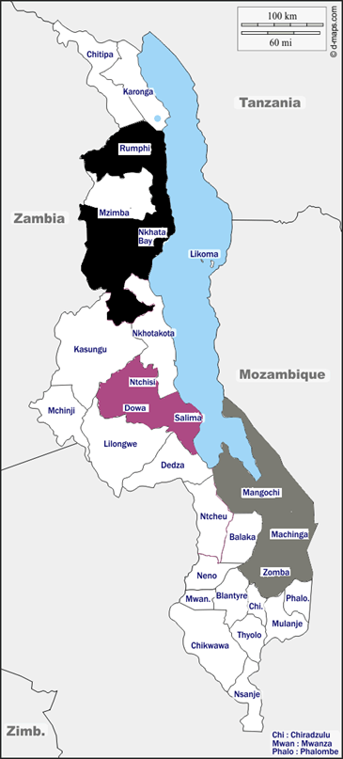
PERFORM2Scale in Malawi
District group | Implementation stage |  |  |  | #Districts | #MSI cycles
Project Year | PY2 - 2018 | PY3 - 2019 | PY4 -2020 | PY5 - 2021
DG1 | MSI1 | MSI2 | MSI2 cont’d | MSI2 cont’d | 3 | 2
DG2 |  | MSI1 | MSI 1 cont’d | MSI 1 cont’d | 3 | 1
DG3 |  |  |  | MSI1 | 3 | 1
DG1 - Dowa, Ntchisi and Salima
DG2 - Machinga, Mangochi and Zomba
DG3 - Mzimba south, Nkhata Bay and Rumphi
Map: ©d-maps.com

Slide 17
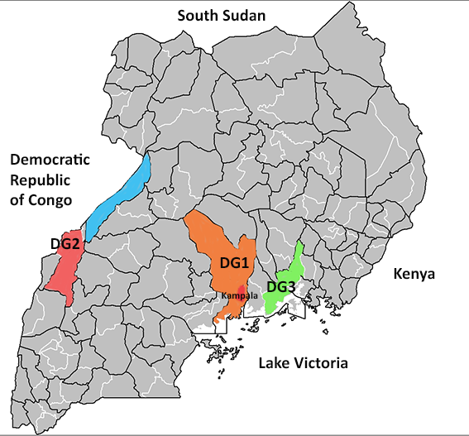
PERFORM2Scale in Uganda
District group | Implementation stage |  |  |  | #Districts | #MSI cycles
Project Year | PY2 - 2018 | PY3 - 2019 | PY4 -2020 | PY5 - 2021
DG1 | MSI1 | MSI2 | MSI3 | MSI3 cont’d | 3 | 3
DG2 |  | MSI1 | MSI2 | MSI2 cont’d | 3 | 2
DG3 |  |  | MSI1 | MSI1 cont’d | 3 | 1
DG1 - Luwero, Nakaseke and Wakiso
DG2 - Kabarole, Ntoroko and Bunyangabu
DG3 - Jinja, Luuka and Buikwe

Slide 18
Key lessons of the Management Strengthening Intervention
The MSI is an effective intervention for management strengthening and can contribute to improved service delivery.
Deepening of DHMT learning occurs through multiple cycles.
It was confirmed that the intervention works despite – or even can benefit from – the absence of extra implementation funds, with DHMTs strengthening their management competencies to become more resourceful and responsive to local needs.
The MSI provides opportunities for district managers to come together to share experiences, learn from each other and overcome challenges.
It was possible to adapt the intervention to better fit with local needs and budget cycles and expand participation, such as the involvement of a wider group of district stakeholders in the MSI.
The flexibility given to districts leads to different solutions and approaches. This in turn results in diverse patterns and situations making outcome monitoring challenging (eg in terms of service or health systems improvement).

Slide 19
Key lessons of scale-up
It is possible to effect considerable scale-up of a complex intervention if the intervention is valued and funds are available for scale-up.
However, scale-up is not a linear process. It is a bumpy road with advances and set-backs along the way, with a range of factors interacting to influence scale-up.
Critical to successful vertical scale-up is having a clear, shared vision among the different stakeholders involved about how to institutionalise (components of) the intervention into existing systems. It takes times to develop this shared vision. Then this vision needs to be translated into a strategic plan for scale-up.
Without vertical scale-up, horizontal scale-up will stagnate and vice versa.
The ExpandNet approach, adapted for PERFORM2Scale, provides a good guide for scale-up, which needs to be flexible to the context and should be adapted as you go on the scale-up journey. Spending time to identify appropriate existing structures to carry out the role of adopting and implementing the intervention at a larger scale and avoid creating parallel structures is critical.
Reappraisal of the need and demand for the intervention at an early stage, including a review of programmes with perceived similarities, should be included in the scale-up journey.

Slide 20
Key lessons of scale-up cont.
Alignment of the intervention to existing policies and interests needs to be considered at the outset. This requires not only in-depth knowledge of the policy environment and relationships with key decision-makers, but also continuous or frequent observation and scanning of the horizon for windows of opportunity and new and important stakeholders.
Evidence is needed to convince stakeholders about scale-up. Major efforts are needed to generate and disseminate convincing evidence. However, it is not only evidence that plays a role in convincing stakeholders of the value of the MSI scale-up. It also depends on the mandate and position of the stakeholders and how they are viewed by others.
Critical to this is the identification of champions and supportive stakeholders to advocate for further funded scale-up to ensure maximum impact and sustainability of the intervention.
Thinking and working politically is essential to identify and anticipate changes in power relationships between key stakeholders and decision-makers that would support or hinder scale-up.

Slide 21
Thank you
www.perform2scale.org
@PERFORM2scale
If you have any questions about these slides, please contact karen.miller@lstmed.ac.uk
Funded by the European Union’s Horizon 2020 research and innovation programme under grant agreement no 733360

