Slide 1

Strengthening management at district level to support the achievement of Universal Health Coverage (UHC)
Add country, CRT and RT names
Add date

Slide 2
INTRODUCTION TO PERFORM2Scale
The project is designed to use a problem-based approach to management strengthening
Phase 1 of the project was tested in Ghana Uganda and Tanzania under the EC-funded PERFORM project (2011-15)
PERFORM2Scale aims to improve health workforce performance by scaling up a cost-neutral approach to management strengthening at district level

Slide 3
PARTNERS
School of Public Health, University of Ghana
The Research for Equity And Community Health Trust, Malawi
School of Public Health, College of Health Sciences, Makerere , Uganda
Swiss Tropical and Public Health Institute
Centre for Global Health, University of Dublin, Trinity College and the University of Maynooth, Ireland
The Royal Tropical Institute (KIT) Netherlands
Liverpool School of Tropical Medicine, UK (overall leadership)

Slide 4
RATIONALE
Need to improve workforce performance to support UHC
District level managers in decentralised contexts, are in better position to organise integrated approaches to improve workforce performance and have sufficient “decision space”
Challenge to help DHMTs to think strategically and to be “entrepreneurial” within their resource and authority constraints
DHMT management strengthening not new, but little research
Notes:
We all know about staff shortages, but staff performance is also needed to achieve UHC
A health systems approach requires all aspects of the system to be considered when improving workforce performance
To achieve this level of integration is challenging, but may be possible at the district level in health system, particularly in decentralised contexts where managers have greater autonomy or “decision space” – hence the selection of Ghana, Malawi and Uganda
It was assumed that working with district health management teams would produce better learning and develop a critical mass, particularly where there is a risk of high turnover
The challenge of PERFORM2SCALE is to help the DHMTs the strategically make the best use of available resources within authority constraints
We recognise that there are many programme designed for DHMT’s management strengthening – but our initial searches showed a gap in the research on this
Managers in decentralised contexts better position to organise and can learn; the assumption is they have more decisions based than their more centralised counterparts; closer to the problem, may be more pragmatic with developing solutions

Slide 5
CORE ELEMENTS
PERFORM MSI
Scale-up mechanism
Process and outcome evaluation

Slide 6
The PERFORM2Scale MSI
PERFORM MSI
Process and outcome evaluation
Scale-up mechanism

Slide 7
MAIN PRINCIPLES OF THE MSI
DHMTs choose problems to address, as this increases ownership of the process
Cost neutral approach
Identify strategies that are realistic and realisable
MSI requires a team approach
Sharing experiences and learning across districts
Strong facilitation skills needed to guide and support the DHMTs
Use the Management Strengthening Intervention (MSI) on a repeated basis to embed the process
Notes:
DHMTs choose problems to address, as this increases ownership of the process; unpredictability
not providing extra resources for the work plans; a challenge in the context of lots of donor funding
not being too ambitious with plans so that strategies are feasible; the primary objective is learning but this takes time over a number of cycles, not fixing (but need some evidence of benefits)
carrying out the MSI as a team; uses skills of the whole team; mitigates problems of turnover; DHMTs don’t always work as teams
sharing experiences and learning across districts; increases the motivation and increases the collective impact
strong facilitation skills of the RT and CRT to guide and support the DHMTs; not the natural habitat of researchers – will address in capacity building, but need to think how best to use team members for different parts of the project
sustaining leadership role throughout the process of the implementation phase. AR work through repeated cycles

Slide 8
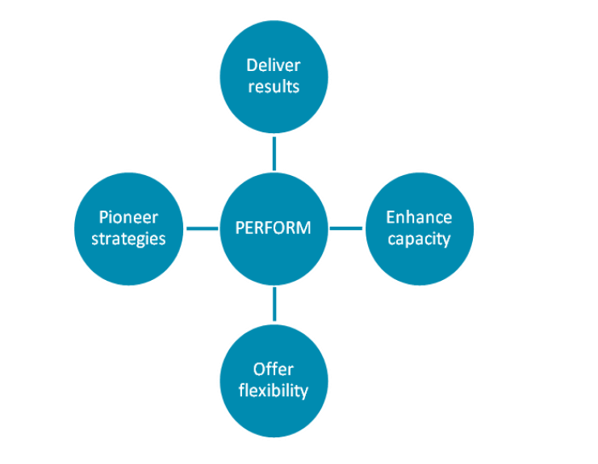
What are the benefits of the MSI for DHMTs?
Deliver results
PERFORM2Scale is an action research project - this means that once you determine the best ways to improve performance, you can implement these changes and monitor their effects in your districts.
Enhance capacity
The action research approach will contribute to your skills and abilities as a DHMT to resolve problems and maximise the use of your resources.
Offer flexibility
You will have the autonomy to design your own strategies for improving the performance of your workforce, with the support of PERFORM researchers. We will work with you to implement these strategies and observe their effects.
Pioneer improvements
You are the first districts to be involved in PERFORM and are therefore pioneers for our project. We hope to utilise learning from PERFORM to support improved health workforce performance in other districts and potentially other countries.

Slide 9
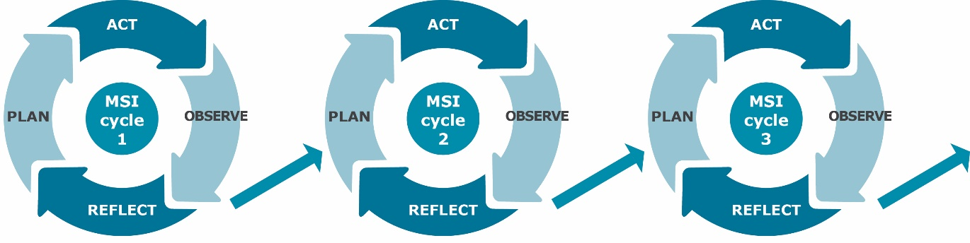
THE MSI CYCLES
The MSI will help DHMTs to solve problems and gradually improve their management competencies

Slide 10
Activities within the MSI cycle
Orient Visit (1 day)
MSI Workshop 1: problem analysis (2 days)
Further problem analysis in district (4 weeks)
Situation analysis (4 weeks): 2 tools; 1 visit by CRT
MSI Workshop 2: develop strategies and workplan (2 ½ days)
Implement strategies (8 months/ 32 weeks)
Monitor effects: 2 visits by CRT
2 inter-district meetings
Plan
Act
Observe & Reflect

Slide 11
SCALING UP THE MSI
PERFORM MSI
Process and outcome evaluation
Scale-up mechanism
Notes:
EC requirement that the project should scale up an existing tested intervention –more interested in lessons of the Scale up in general.

Slide 12
The Expandnet/WHO framework for scaling up
Context
MSI
NSSG
RT
Vertical
Horizontal
Diversification
Spontaneous

Slide 13
MANAGEMENT COMPETENCIES TO BE PROMOTED IN THE MSI
Identification of root causes of problems
Prioritisation of problems
Designing integrated Human Resource Management and health systems strategies appropriate to context
Resourcing
Following through the implementation to overcome barriers

Slide 14
KEY PROCESSES IN THE SCALE UP OF MSI
Building and maintaining engagement
Establishing structures
  National Scale-up Steering Group (NSSG) – oversight
  Resource Team (RT) –facilitation
Capacity building
Site selection
Rolling out MSI cycles
Improving plan for scale-up

Slide 15
EVALUATING THE SCALE-UP
PERFORM MSI
Process and outcome evaluation
Scale-up mechanism

Slide 16
PROCESS EVALUATION
How is the scale-up being implemented?
Why is it being implemented in that way?
What are the barriers and facilitators to implementation?
Ongoing process evaluation
Initial
Context
Analysis
Notes:
• How is the scale-up being implemented and what are the differences in implementation over time and in different environments or contexts?
• Why is it being implemented in this way and how have different actors influenced the scale-up process?
• How have the political structures and power relations shaped the motivations of different stakeholders and institutions and their behaviours to implement this scale-up?
• What are the barriers and facilitators to implementation?
• How appropriate are the vertical and horizontal scale-up strategies for each context and across the different contexts?

Slide 17
OUTCOME EVALUATION
Has management strengthening taken place?
Has workforce performance improved?
Has there been improvements in service delivery and utilisation?
What are the costs involved in the scale up?
Notes:
We will get detailed costs

Slide 18

ACKNOWLEDGEMENTS
Funding is from the European Commission Horizon 2020 programme
Notes:
E

Slide 19
QUESTIONS?

Slide 20
Thank you!

